Slide 1
Woodlands CS Club
GNU/Linux (on a diet)
2021-01-18

Slide 2
Introduction to Linux
Linux is a group of open-source operating systems based on the Linux kernel
The Linux kernel is a unix-like OS kernel (core of the OS) created in 1991 by Linus Torvalds, grew from many individual contributions
GNU is a system of software (known as "packages") that is used around the Linux kernel
There exists many distributions (or "distros") of Linux such as Arch, Debian, RHEL, Fedora, etc.
Most servers run some form of Linux, Windows Servers just don't have the performance and support and also licensing costs are insane

Slide 3
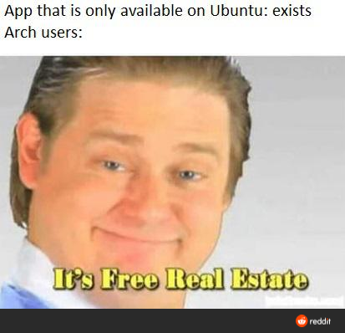
What is a "distro"
A Linux distro is an operating system based on the Linux kernel, however different distros will have different different pre-installed packages, design philosophies and package managers.
Common Linux distros are: Debian, Ubuntu, Arch, Gentoo, Fedora, RHEL
Release types: Rolling vs Static (like Windows)
They could potentially be software that only runs on certain distros. Though, you could sometimes port over software made for other distros to run with whatever you want.

Slide 4
Package Managers
The package manager of a distribution determines the way its users could download packages from the distro's "package repositories" and CANNOT be changed.
Package repositories are a collection of binaries and builds of different software projects which a user could run on their system.
Different package managers are made from different programming languages and have different commands (or graphical utilities) to control them.

Slide 5
Finding Software and Games
(preferred) most software could be found in your distributions package managers
(less-preferred, bloat) PM Alternatives → Appimages, Flatpaks, Snaps, etc…
Use this if:
software you want isn't in your PM
the PM version is not a version you want, aka you want nightly builds, etc
(last resort) Build from Source
Support could be limited
Some people would be uncomfortable doing this
Gets the exact version you want
Quick Note About Games → Proton, Steam, etc

Slide 6
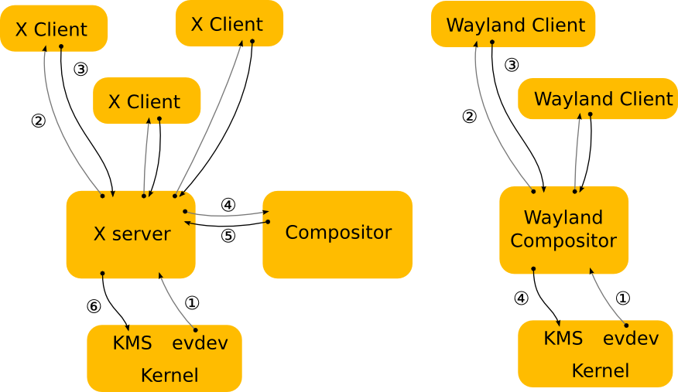
Xorg and Wayland; Desktop Environments, Window Managers and Compositors
Display Servers → Wayland and Xorg (95% ish of people use this)
Desktop Environments (too common, not even funny)
Contain an ecosystem of components to be complete → WM, Compositor, Notification server, Bar, App Launcher, Display Manager, Lock and other DE-specific software, etc
Freedesktop compliant DEs (most are) provide the best support
Examples: Gnome, KDE, XFCE, LXDE
Compositors
communicate with the display server to determine how windows should be rendered
Display Server specific
Sometimes included with WM
Window Managers → i3, bspwm, dwm, xmonad, jwm, herbstluft, AwesomeWM, etc…
Requires other freedesktop compatible components to make it functional
Configs are much more reproducible and could be easily backed up
Too advanced for 99% of linux users
At least 10 times more customizable

Slide 7
Trying out Linux
Live USBs
zero commitment
requires a bit of tinkering if inexperienced
literally the installation iso basically
Virtual Machines (VirtualBox, VMware, Zen, KVM/QEMU, etc…)
more realistic
harder to setup and might deter non-power users (apparently…)
requires space and hardware resources
Bare Metal Install (eg. dual boot, second drive)
highest commitment but is the best way to test out (ie. if you distro hop)
Note about Distro Hopping and finding distros: distrowatch

Slide 8
Q&A and Nathan's Experience with Linux

